Slide 1
Narrative
From media to interactive media

Slide 2
Do the quiz on Moodle!

Slide 3
Discussing the reading
Look at last week’s reading (on Moodle)
Make notes about things that don’t make sense - discuss them
Skip to the parts that seem relevant
Discuss how it might be useful as a media producer

Slide 4
‘Constructing’ audiences?
The literal audience is who literally watches/listens/reads
The virtual audience is the audience that is ‘sold’ to advertisers, e.g. ‘affluent over-40s in suburban towns’
A story also constructs an audience through its language and focus, e.g. British urban young liberal educated
Example: lots of stories about train companies, not many about buses. Why? Most media workers don’t use buses.

Slide 5
Your Narrative blog

Slide 6
Get set up on Medium.com
Sign up to Medium,
Let us know your username (the bit after medium.com/@ in the URL)
We will add you to the publication for this module
See the guide on Moodle for more on using Medium

Slide 7
Chapter 2:
Using elements of narrative

Slide 8
Defining narrative: Mieke Bal
Should contain an actor and a narrator*; 3 distinct levels: the text, the story, and the fabula; Contents should be “a series of connected events caused or experienced by actors.”
*Actor and narrator can be same; narrator can be ‘effaced’

Slide 9
For example...
Snow White has a series of elements [fabula]: events, characters, places, times
Multiple stories can be created by choosing and ordering those in different ways (content) (BBC, BuzzFeed, Sun)
Multiple texts can be created by telling any story using different media, etc. (film version, book, animation, audio)

Slide 10
How to use this as a storyteller...
Characters: do we want to know more?
Setting: where does the action take place? (Umwelt)
Movement: characters and settings provide movement, e.g. chemistry/conflict; switching scenes

Slide 11
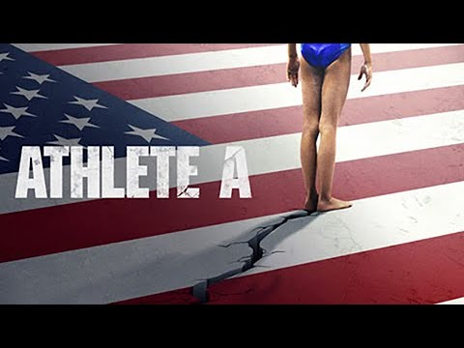

Slide 12
Athlete A
Characters: athletes, parents, trainers, authorities
Setting: competitions, clinic, police station, court
Movement: ambition, reporting, arrest, prosecution, meetings

Slide 13
Harry Potter/Star Wars?
Characters:
Setting:
Movement:

Slide 14

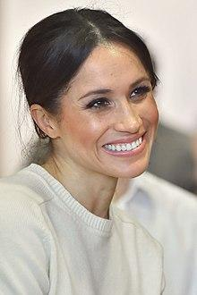
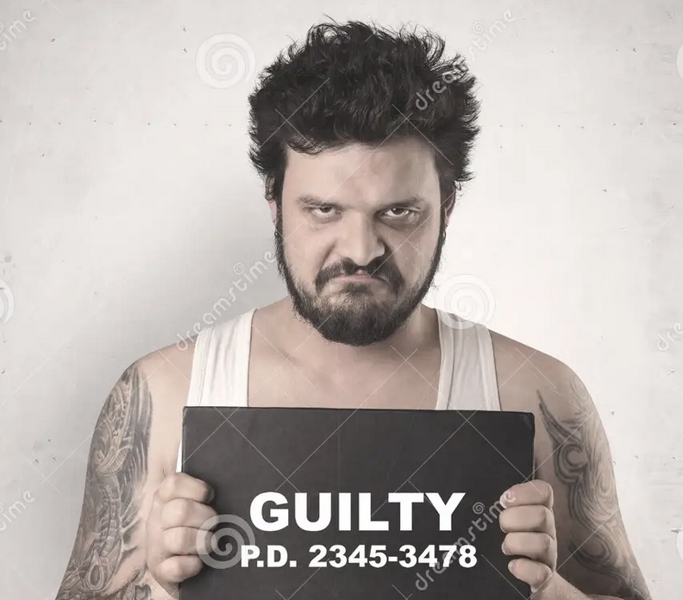

Are you ‘casting’ heroes/villains?
Avoid stereotyping: people are complex and motivations are important.

Slide 15
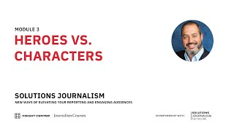

Slide 16
Setting as character: VR
“There are those instances VR and 360 video actually adds something. And those are cases where the place is really important. The place is almost a character. And if we can take people to that place through VR, then we want to be able to do that.”
William Widner, New York Times

Slide 17
This is what you should know.
Narrative concepts help break down the problem of telling a story — and identify new challenges
Look for characters, setting and movement in your subject, to provide ideas on how to tell the story
But narrative genres and techniques raise problems too: we need to anticipate and address those

Slide 18
Do it now.

Slide 19
Workshop 1: The narrative interview
Interview a fellow student about their life story, or an event in their life. You will need to be able to tell their story to others. To begin with, let them talk as much as possible.
Listen, and ask follow up questions about characters, settings, movement, events (a form of movement)
Make a list of those characters, settings and movements

Slide 20
Example:
Characters | Settings | Movement between those
Harry Potter |  | HP is friends with Ron/Hermione
Voldemort |  | Voldemort wants to kill HP
 | Hogwarts dining hall | Arrive from station
 | Platform 9 3/4 | Travel to school

Slide 21
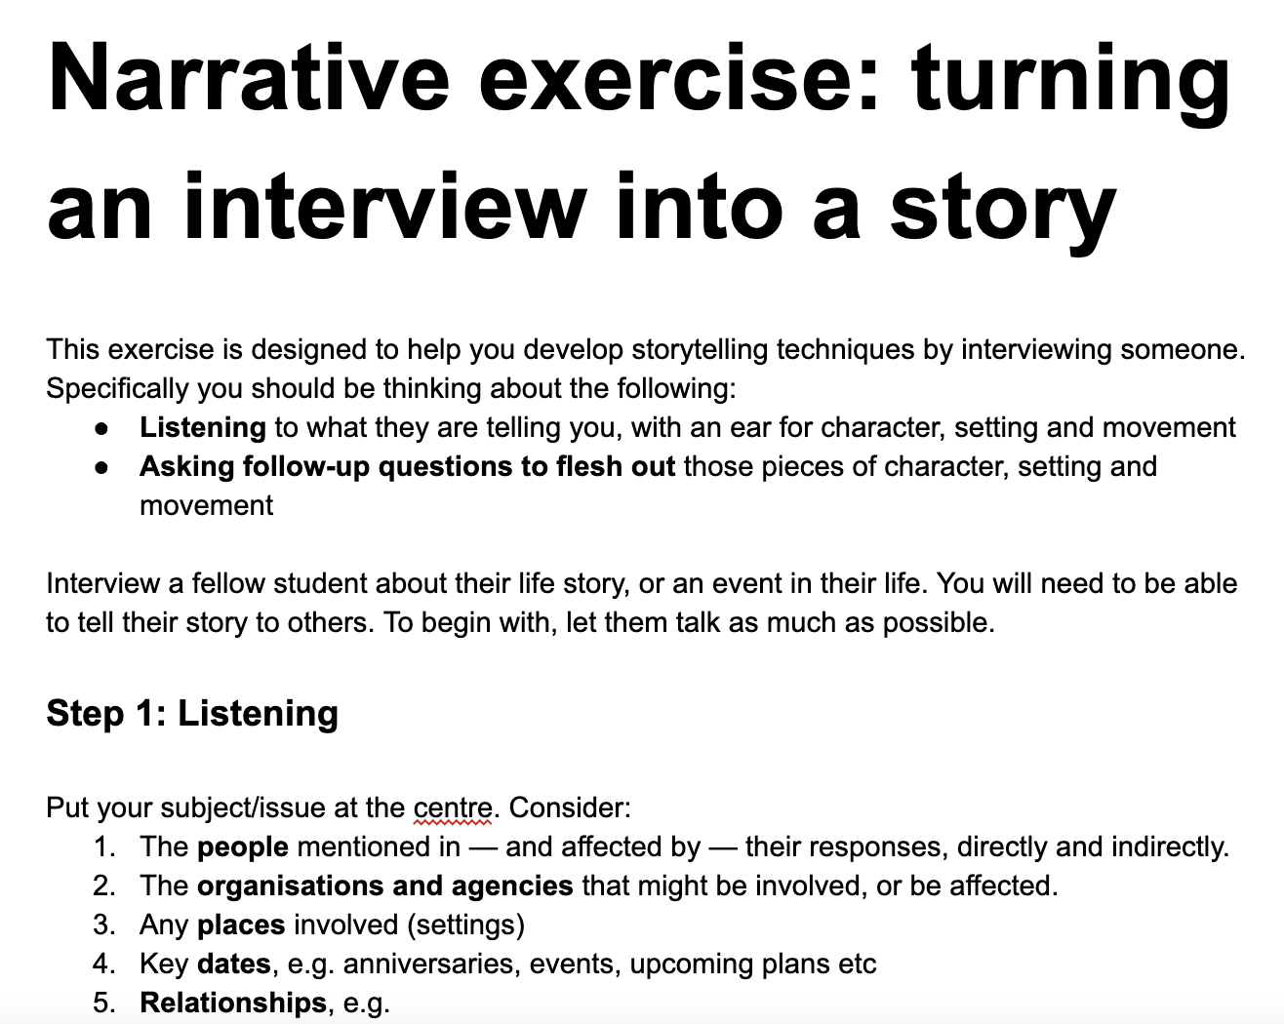
(It’s on Moodle too)

Slide 22
Workshop 2: Identifying stories
Look at the elements you’ve listed (characters, setting, movement).
Which elements might be a driving force for a story?
What is the point of that story? Is there a better option?
Plan a story using some of those elements: “a series of connected events caused or experienced by actors.”
Are there any gaps? Questions they raise?

Slide 23
Story — or anecdote?
Anecdotes are just a sequence of events (without a point)
Stories have a structure — and a point
An anecdote is often part of a story (e.g. the opening) but weave in the ‘point(s) of reflection’ mentioned by Ira Glass

Slide 24

"It's very hard to give a clear definition of what works and what doesn't. But a good starting point would be to look for a "character or situation that is in flux".
http://www.journalism.co.uk/news/how-the-bbc-approaches-longform-immersive-storytelling/s2/a557573/

Slide 25
Apply the concepts from the reading
Who is your imagined audience?
How can you use temporality in your story? Pacing?
How long should the story be? (Duration)
Mimesis vs diegesis (show vs tell)?
Metaphor, metonym, synecdoche?
Cortazzi’s structure (we’ll talk about this more next week)

Slide 26
Time, mimesis, and other demons

Slide 27
What you should know...
Choices to make about the narrator
Tools to consider around temporality and pacing
How to use showing vs telling in your work

Slide 28
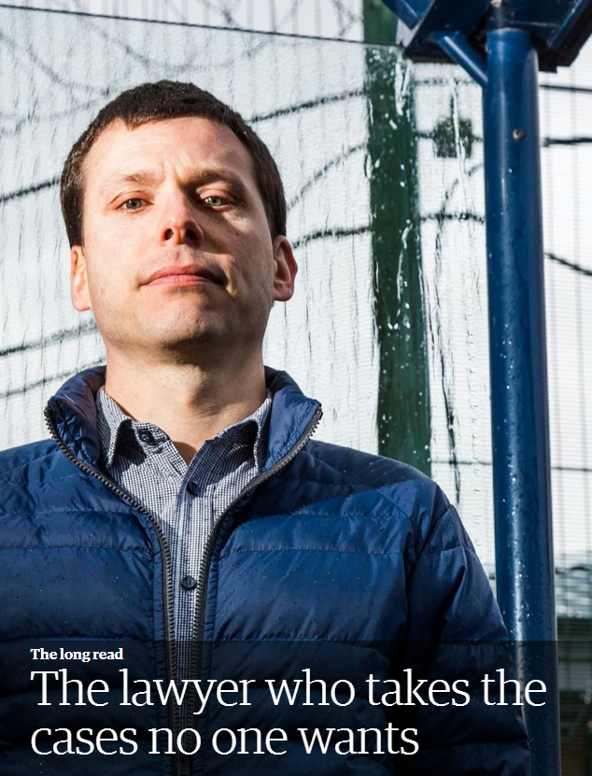
Present vs past tense
“Two or three times a month, Tom Giles says goodbye to his wife and three children at their home in Abingdon, and drives north…”
https://www.theguardian.com/news/2016/apr/14/the-lawyer-who-takes-the-cases-no-one-wants

Slide 29
Key points
Identify the ‘speaking subject’ and their role in your story: effaced, third or first person?
Consider temporality and pacing: how do you ‘cut’ to create movement/tension?
Show, don’t tell? Switch from show to tell to create movement/tension

Slide 30
Question yourself
Are we just picking the easiest story to tell?
Are we letting generic formats dictate how we tell those? Do characters become archetypes - cliches?
How do we prioritise the right story to tell - and tell it well?

Slide 31
The resolution...

Slide 32
Key points to remember
Map out the elements (the ‘fabula’) to help you plan your stories effectively
Look for movement between characters and settings
Make sure there’s a point to it all: why are you telling this story?

Slide 33
What happens next?

Slide 34
Reading
Media Production/PR students: pick any chapter from the Living Handbook of Narratology - link on Moodle
Data Journalism students: read Why Do I Care? from Mark Blaine (2014) The Digital Reporter’s Notebook - on Moodle
Make notes on how you can use the ideas in your own work - keep notes for your evaluation

Slide 35
Directed study: analysis expanded
On Medium, based on your notes from the last directed study write a critical analysis of one or more media stories in your field.
How have they used character, setting and movement? Why?
What decisions have they made around temporality, mimesis, and other narrative concepts (see reading)?

Slide 36
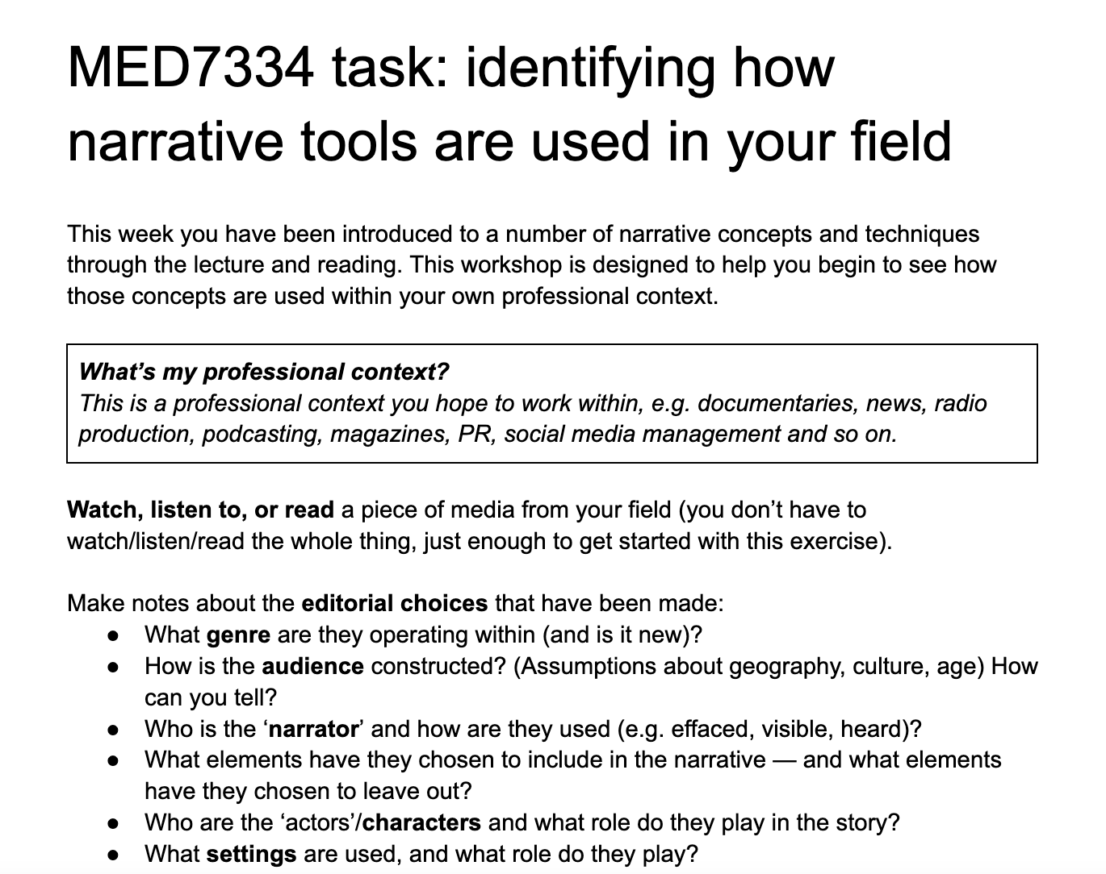
(It’s on Moodle too)

Slide 37
Directed study 2: a story (optional)
Have a go at writing a story based on the notes from today’s interview.
Don’t worry about it being any good: focus on getting started and having something to discuss with others.
Use it as evidence in your assignment!

Slide 38
https://medium.com/narrative-from-linear-media-to-interactive-media/s-town-how-it-uses-narrative-techniques-bb0922bf5971

Slide 39
https://medium.com/@karthik.ms/a-critical-analysis-on-wiki-death-40e09da65e3c

Slide 40
Questions?

Slide 41
Extra: mapping the territory
(More on Moodle): for a subject of interest, map out:
What characters or types are there?
What settings?
What movement (conflict, chemistry, physical, emotional)

Slide 42
For example… environment
Character/types: protestors, regulators, CEOs, inspectors, MPs, victims, families
Settings: protest, boardroom, factory, bedroom
Movement: protestor vs police; lawyer vs lawyer; employee turns whistleblower/marries protestor; CEO changes policy; MP campaigns for new law

